Slide 1
COMP 6651 Algorithm Design Techniques Week 10
Backtracking.
(some figures are taken from textbook)

Slide 2
Back to complexity
Constant
Logarithmic
Binary Search
Linear
Greedy
nlogn
Comparison based Sorting
Polynomial
Shortest path
Pseudo-polynomial
Dynamic Programming
Larger: exponential, factorial
Hamiltonian cycles

Slide 3
Types of Problems
Decision problems
Is this graph connected?
Is this number prime?
Optimization problems
Constructive (find something)
Search problems: find a specific element of a set

Slide 4
Search Problems
Find a solution out of a set of solutions
Find an element out of a set of elements
Examples:
Find min, max, median: find an element from a set, assuming a total ordering (cardinality: n)
Sorting: find …. out of ….
Sorting find a permutation out of the set of all permutations (cardinality: n!)

Slide 5
Search Problems
Examples:
Leap- frog; sequence o steps out of all sequences of steps
Graph: BFS, DFS, spanning tree

Slide 6
Search Problems
Always the option to try all possible elements
Usually very expensive
Strategies:
Dramatically Reduce your space of search (divide and conquer)
Chose iteratively the elements based on a local minimum (Greedy)
Bottom up construction where we remember the previous solutions (Dynamic Programming)
If none of this works: backtracking
Try all possible combinations

Slide 7
Classical backtracking problems
N- queens (and variations)
Find all permutations (anagrams)
Travelling Saleseman Problem (aka Finding all Hamiltonian Cycles)
Longest possible route in a graph
All k – colorable configurations in a graph
Constrained satisfiability
Etc.

Slide 8
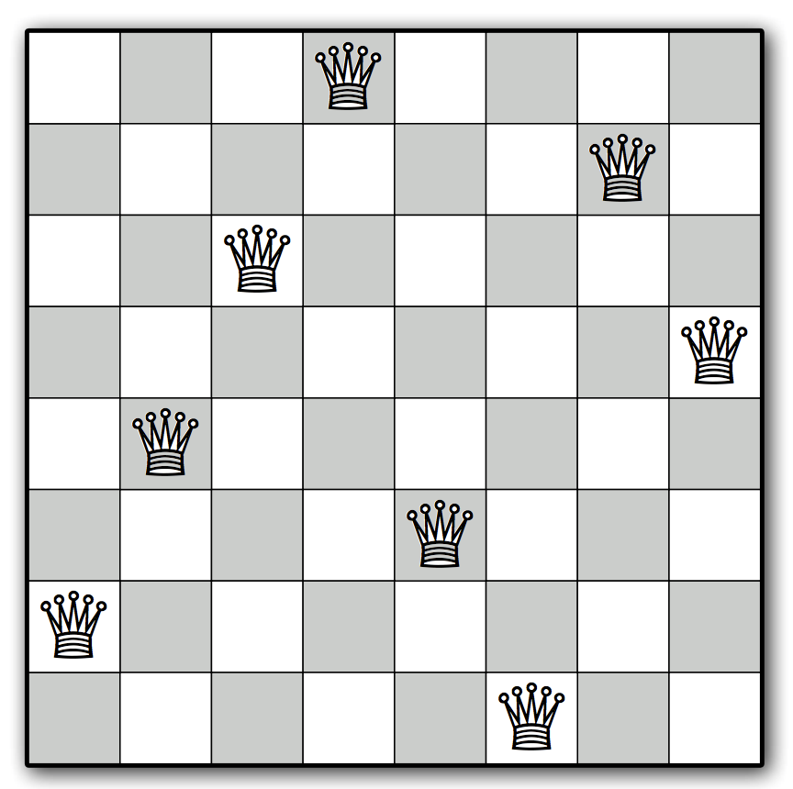
N-queens problem

Slide 9
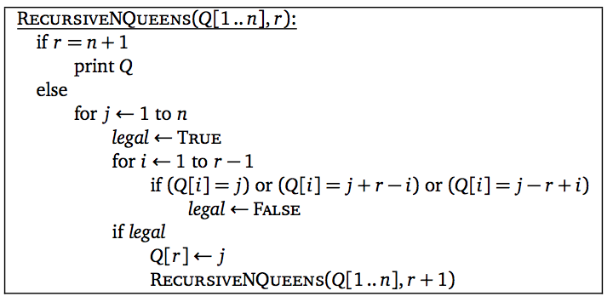
Pseudocode
j + (r - i)
j - (r - i)
Same cols
Check right diagonal
Check left diagonal
[U of Illinois]

Slide 10
K coloring

